Slide 1

Blood Bank Management system
Sumit Das
Roll: 1909044
Dept: ECE

Slide 2

Agenda
Introduction
ER Diagram
Schematic Diagram
Tables & attributes
Examples

Slide 3

INTRODUCTION
This Project aims to automate the process of blood bank management. Doctors can easily find available blood types and identify potential donors. Donors can be informed and be notifies when their blood type is in demand. Blood banks can effectively manage their inventory, keeping tracks of blood units and their expiration dates. Patients can quickly find the blood they need. By utilizing SQL’s powerful features, the project intends to streamline the operations of blood banks, thereby ensuring timely and efficient service for all parties involved.

Slide 4
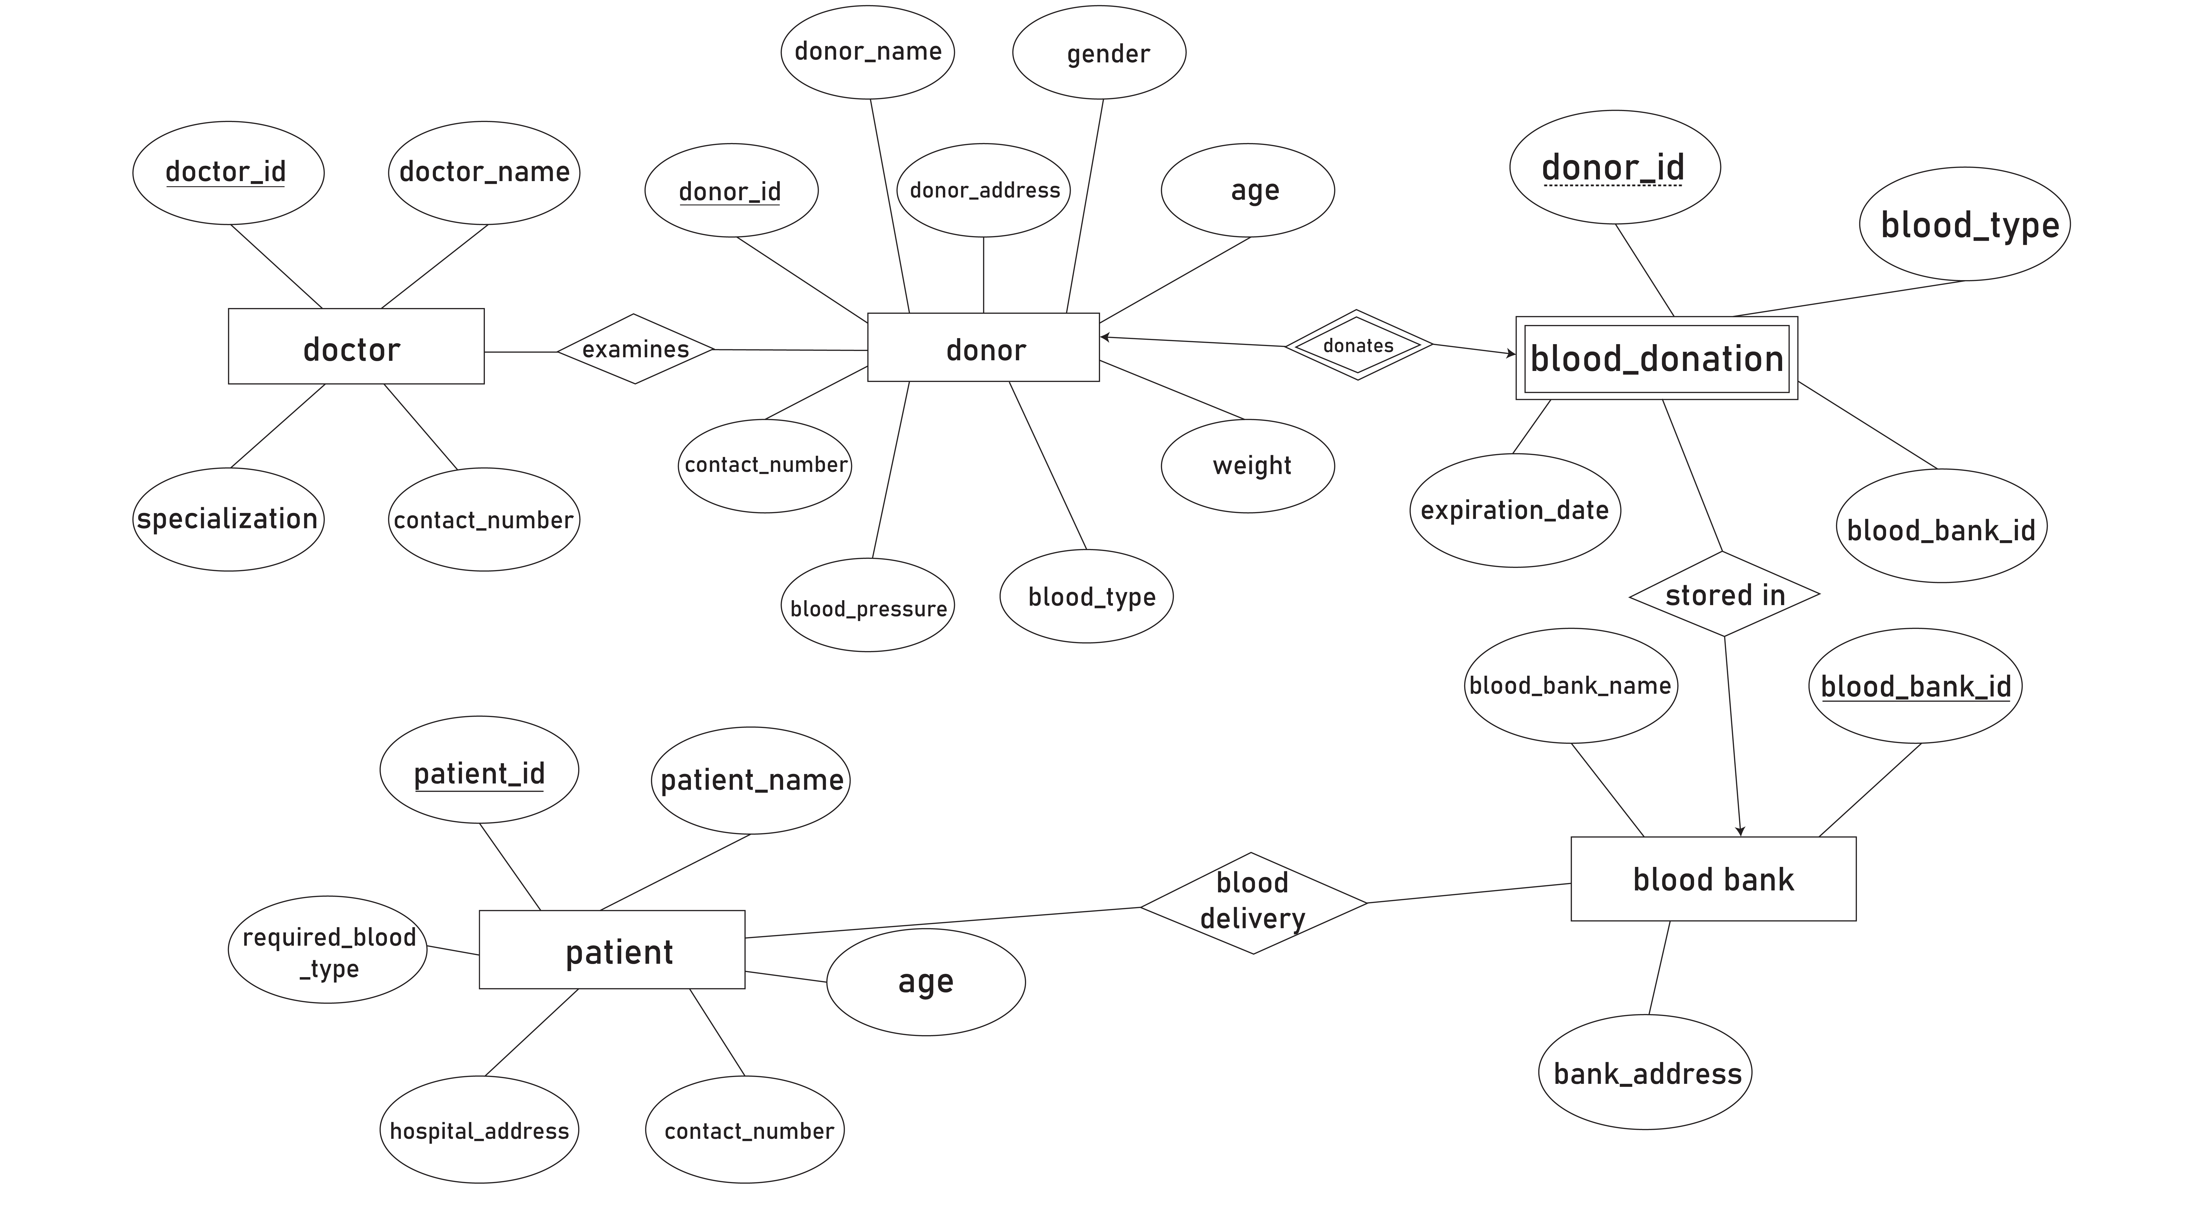
ER DIAGRAM

Slide 5
Tables & attributes
Tables | Attributes
Doctor | doctor_id, doctor_name, specialization, contact_number
Donor | donor_id, donor_name, donor_address, gender, age, weight, blood_type, blood_pressure, contact_number, doctor_id
Blood_donation | blood_type, expiration_date, donor_id, blood_bank_id
Blood_bank | blood_bank_id, blood_bank_name, bank_address
patient | patient_id, patient_name, age, required_blood_type, hospital_address, contact_number

Slide 6
Example table
Doctor table
Donor table
doctor_id | doctor_name | specialization | contact_number
1 | Dr Sumit | 01711111111 | Cardiology
2 | Dr Amit | 01722222222 | Neurology
donor_id | donor_name | donor_address | gender | age | weight | blood_type | blood_pressure | contact_number | doctor_id
1 | Rakib | Mirpur, Dhaka | Male | 24 | 150 lbs | A+ | 120/80 | 01500000001 | 1
2 | Priom | Gopibagh, Dhaka | Male | 24 | 188 lbs | B+ | 130/90 | 01500000002 | 2

Slide 7
Example table
Blood_bank table
Blood_donation table
blood_bank_id | blood_bank_name | blood_bank_address
1 | KUET Medical | KUET, Khulna
2 | Khulna Medical | Khulna
blood_type | expiration_date | donor_id | Blood_bank_id
A+ | 06-NOV-23 | 1 | 1
B+ | 06-NOV-23 | 2 | 2

Slide 8
Example table
Patient table
patient_id | patient_name | age | required_blood_type | hospital_address | contact_number
1 | Naeem | 24 | B+ | Khulna Medical | 01900000029
2 | Alvi | 24 | A+ | KUET Medical | 01900000013
3 | turna | 23 | O+ | KUET Medical | 01900000009

